Slide 1
Credit Card Overview

Slide 2
Type of Cards
Debit Cards
Credit Cards
Charged Cards
Prepaid card / Gift Card
Co-Branded Cards
Private label Cards
Virtual card

Slide 3

Entities involved in a card transaction
Cardholder:
Owner of the card making a purchase.
Merchant:
Business / Store accepting credit card payments for products or services sold to the cardholder.

Slide 4
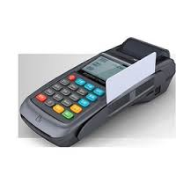
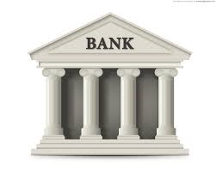
Entities involved in a card transaction
Acquirer:
Financial institution or other organization that provides card processing services to the merchant.
Issuer:
Financial institution or other organization that issued the credit card to the cardholder.

Slide 5
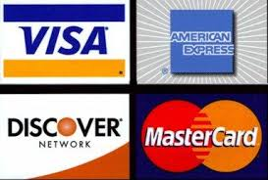
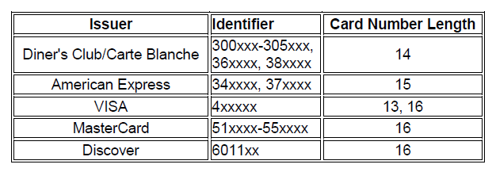
Entities involved in a card transaction
Card association / Networks / Schemes
Acts as a gateway between the acquirer and issuer for authorizing and funding transactions.
Issuer Identifier (BIN /ICA)

Slide 6
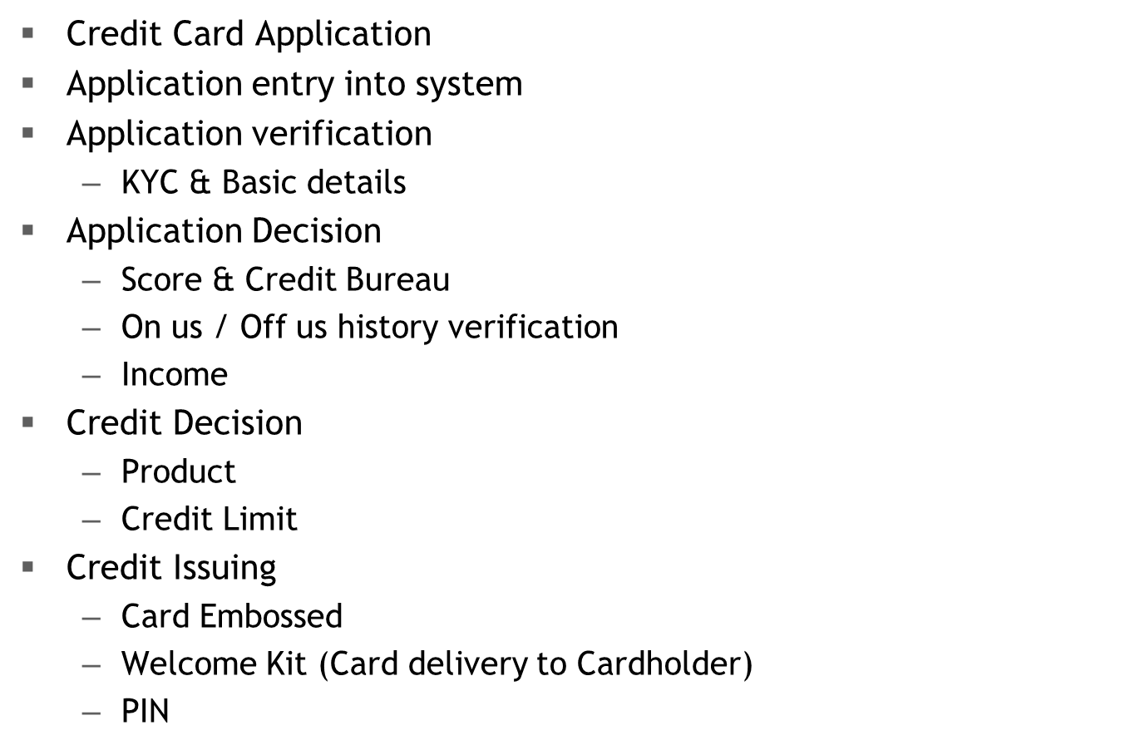

Customer Acquisition & Fulfillment

Slide 7
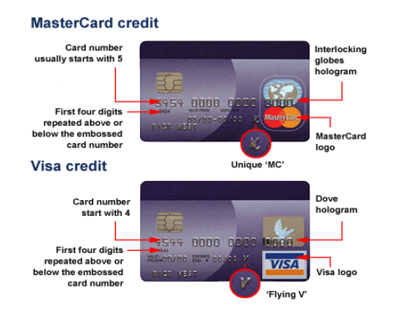
Credit card - Plastic

Slide 8
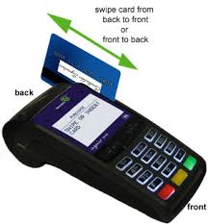
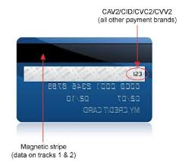
Credit card - Plastic
Magnetic cards
Information on the card, card holder and card issuer is encrypted in the magnetic strip

Slide 9
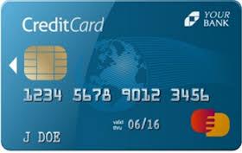
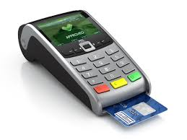
Credit card - Plastic
Smart cards / Chip Card / EMV Card
Cards with a microprocessor chip instead of the magnetic strip
Chip is able to store more information than cards with magnetic strip

Slide 10
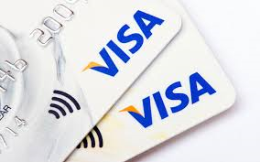
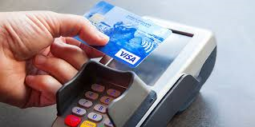
Credit card - Plastic
Contactless cards
Pocket-sized card with embedded integrated circuits that can process and store data, and communicate with a terminal via radio waves

Slide 11
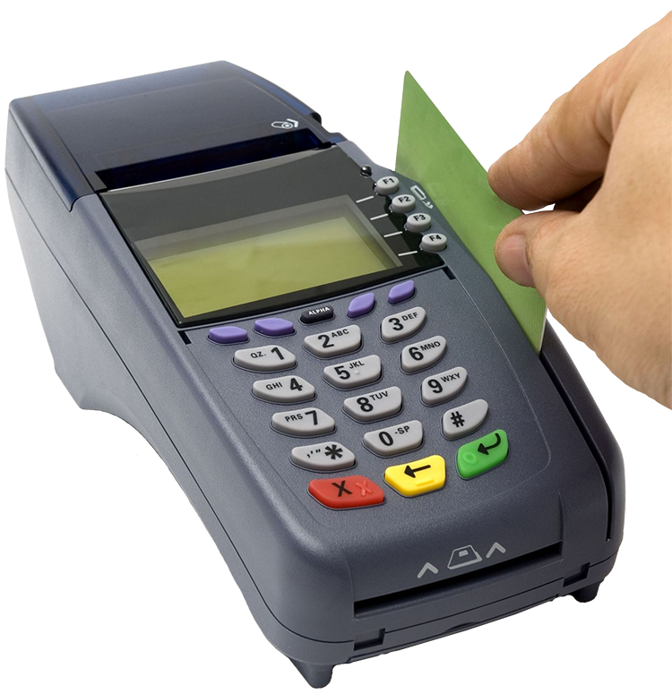
Account Authorization
Decline
Approve
Refer
POS
Customer

Slide 12
Authorization Flow
Authorization
Request
NETWORK
Authorization
Response
ACQUIRER
ISSUER
Authorization
Request
Authorization
Response
Merchandise
MERCHANT
Credit Card

Slide 13
Online vs Offline transaction
Online transaction
Any POS transaction or ATM transaction that reaches the Issuer directly or via schemes is considered as online transaction.
On-us: - If Issuer and acquirer are same then it‘s called as On-us transactions.
Off-us: - If Issuer and acquirer are different then it‘s termed as Off-us transactions.
Offline transaction
Offline transactions can be performed only using chip cards.
Any transaction that doesn‘t reach the issuer and is completed between the POS and the Card is called as Offline transactions.

Slide 14
Interchange Flows
Clearing
$100
Sales Slip
$100
Sales Slip
$100
Sales Slip
$100
Sales Slip
Banking
Acquirer
Merchant
Bank
Banking
Issuer
Cardholder
Bank
Card-
holder
Store
Merchant
Card
Schemes
Card-
Holder
Acct
$97
(Settlement)
$98
(Settlement less merchant bank discount $3)
$99
(Settlement less Interchange Fee)
$100
Payment
Settlement

Slide 15
Billing
Trans action Posting
Account Conditions
Transaction Posted / Rejected / Warehoused
Interest Computation
Cash Type of Transactions
Retail / Purchase Type of Transactions
Insurance
Insurance
Premium
Enrollment Age
Expiry Age
Grace Days
Cancellation
Fees
Cash Advance Fee
Mark-up / Forex Fee
Late / Overlimit / NSF Fee
Annual Membership Fee
Tax / VAT / Stamp Duty

Slide 16

Statement
Purchase
Purchase
Payment
Statement
Print
Image
Posted
1
2
3
4
5
6
7
8
9
10
11
12
13
14
Statement Requested
15
16
17
18
19
20
21
22
23
24
25
26
27
28
29
30
31
Accounts Receivable System
Billing Date Arrives
Payment Due date
Minimum Amount Due

Slide 17
Delinquency
Failure to make a payment on an obligation when due.
The level of delinquency based upon the age of past due.
Liquidation interest on delinquent account
Aging on Payment due date or cycle date
Underpayment by Payment variance amount

Slide 18
Collections
Balance
Account
Evaluated
on
Various
Conditions
Time Past Due
Collections System
Risk Level
Delinquent Accounts Sent
Accounts Are Sorted Based on Pre-determined Criteria
Etc.

Slide 19

Collections
Accounts are queued for collection based on business defined Collection Strategies
Collectors attempt to contact customers. Results (i.e. Promises-to-pay) are recorded for follow-up. Letters are requested, as needed.
Collections System
Priority 1
Priority 2
Priority 3
Collector Using Collection System

Slide 20

Rewards
Reward Point on Purchase / Cash Transactions
Bonus Reward Point
Anniversary
First Usage
Birthday
Reward Redemption
Cash Back
Third Party Vendor
Internal
Reward Expiry

Slide 21
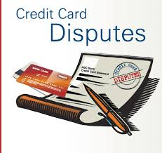
Transaction Dispute
Dispute Initiation and Verification
Retrieval Request /1st Presentments
Charge Back
2nd Presentments
Arbitration (Schemes)
Dispute release in favor of Bank / Customer

Slide 22
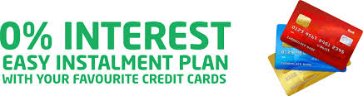
Loans
Open Ended Loans
Close Ended Loans
Loan With-in the credit limit
Loan Above the credit limit
Installment plan (EPP)

Slide 23
Fraud
Falcon
Rules Setup to determine Fraud
Cardholder Details – Holidays etc.
TRIAD
Scenarios & Strategies
Schemes
Fraud detection rules at schemes end
Lost & Stolen
Hotlisting

Slide 24
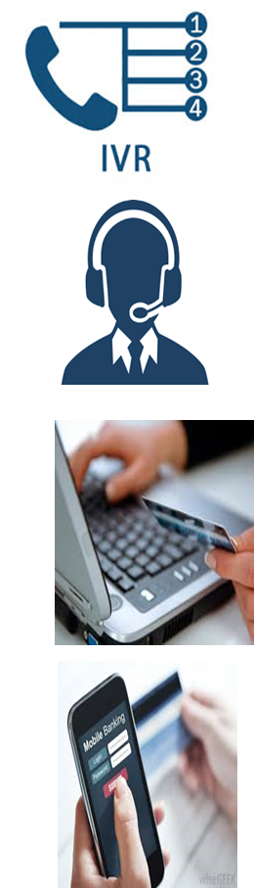
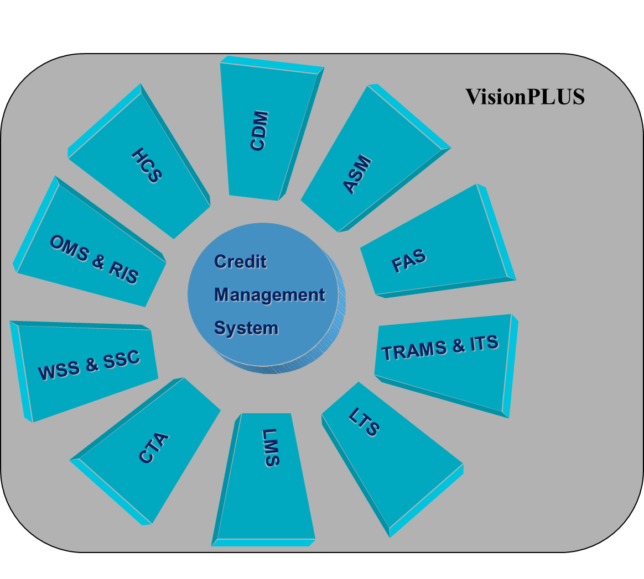
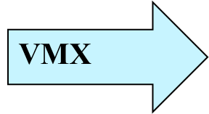
VisionPLUS® Modules

Slide 25
Channels
Teller / Branch - This is the most primitive channel used in banking. Teller is the person who sits in a bank branch and assists every customer with withdrawal and deposit of cash and balance enquiry.
ATM - ATM networks link the ATMs of a bank or group of banks, allowing the cardholders of the bank(s) in question to use the ATMs of the network regardless of their location. Automated Teller Machines (ATM) is the most convenient method for withdrawing, depositing cash. It is also used for balance enquiry, mobile top-up, bill payment, mini statement, deposit (using debit card), and PIN change transactions.
Point of Sale (POS) - POS networks link point-of-sale terminals and allow the use of payment cards for the purchase of goods and services in various locations. Point of Sales (POS) is the terminal which could be seen at retail outlets for making payments via debit/credit and pre paid cards. It eliminates the need for carrying cash every time you shop.
IVR - Interactive Voice response (IVR) is the technique which uses a pre-recorded voice that interacts with the Customer and prompts them to use keypad inputs for making a payment.
Online Banking - This is the channel which uses internet as the medium of communication. User enters any online portal via a secured user-id and password and fills in the respective forms for any kinds of transaction to be performed. Online banking came into existence almost 8 years ago in India.
Mobile Banking - Mobile Banking refers to provision of banking- and financial services with the help of mobile telecommunication devices. The scope of offered services may include facilities to conduct bank and stock market transactions, to administer accounts and to access customized information.

Slide 26


Slide 27
Thank You !

